Slide 1
AI-Powered Multimodal Misinformation Detection and Verification System
Presented By:
Vaishnavi Prasad
Nemuel Sam Jerry
Fathima Marjan M
Twinkle Francis
Project Guide: Nayana Chandran
Assistant Professor
Department of Computer Science & Engineering

Slide 2
Abstract
Rapid growth of AI-generated content and deepfake technology has increased the spread of misinformation.
Existing fake news detection systems mainly focus on a single media type, limiting their effectiveness.
Proposed an AI-powered web application to detect misinformation in text, PDF documents, images, and videos.
Uses DistilBERT for text analysis, EfficientNet for image analysis, and a video analysis model for video analysis.
Combines predictions using a Multilayer Perceptron (MLP) and provides transparent explanations through SHAP Explainable AI.
Aims to provide accurate, scalable, and explainable multimodal misinformation detection through a unified platform.

Slide 3
Introduction
Social media has accelerated the spread of misinformation across digital platforms.
AI technologies have enabled the creation of convincing fake text, manipulated images, and deepfake videos.
Manual verification of such content is time-consuming and often unreliable.
Artificial Intelligence can automatically analyse multiple media types to identify misinformation.
The proposed system combines Natural Language Processing (NLP) and Computer Vision (CV) techniques to verify information from text, PDF documents, images, and videos within a single platform.

Slide 4
Problem Statement
The rapid spread of misinformation across digital platforms has become a significant challenge due to the increasing use of AI-generated content, manipulated images, and deepfake videos. Existing misinformation detection systems often focus on a single media type, resulting in limited accuracy and a lack of comprehensive verification across multiple content formats. Furthermore, many existing solutions provide little or no explanation for their predictions, making it difficult for users to trust the results.

Slide 5
Existing System
Paper 1: Advanced Machine Learning Techniques for Fake News (Online Disinformation) Detection: A Systematic Mapping Study
Machine learning techniques for fake news detection.
Mainly focused on text-based misinformation.
Paper 2: A multi-level fusion-based framework for multimodal fake news classification using semantic feature extraction
Multimodal fake news detection using semantic feature extraction.
Supports text and image analysis.

Slide 6
Paper 3: A fake news detection model using the integration of multimodal attention mechanism and residual convolutional network
Multimodal attention mechanism with residual convolutional networks.
Improves image-text classification accuracy.
Limitations
Limited support for multiple media types.
No unified platform for text, PDF, image, and video verification.
Limited explainability of AI predictions.
Real-time verification remains a challenge.

Slide 7
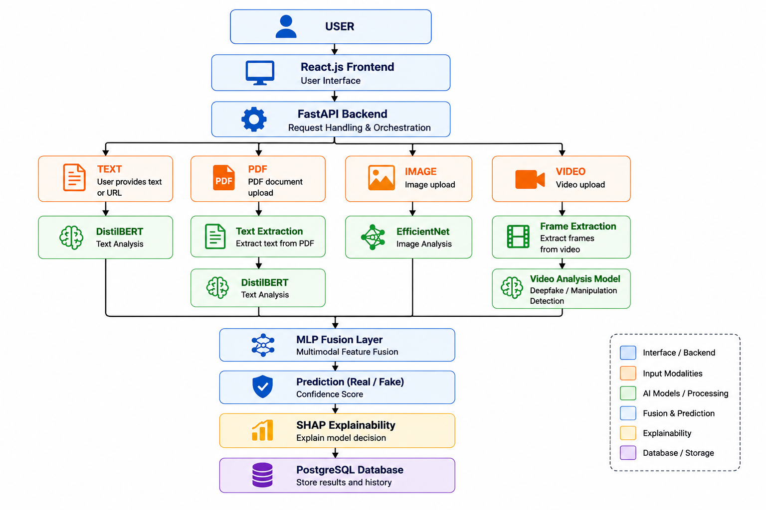
Proposed System
The proposed system provides a single web platform for detecting misinformation from multiple media sources.

Slide 8
Functional Requirements
Accept text input for analysis.
Upload and analyse PDF documents.
Upload and analyse images.
Upload and analyse videos.
Extract text from uploaded PDF files.
Detect misinformation using AI models.
Display prediction (Real / Fake) with confidence score.
Provide SHAP-based explainability for the prediction.
Store analysis results in the PostgreSQL database.

Slide 9
Software Requirements
Windows 10/11 or Linux
Python 3.10+
React.js
FastAPI
PostgreSQL
PyTorch
OpenCV
FFmpeg (Optional – Video Processing)
Hugging Face Transformers
SHAP
PyMuPDF
Git & GitHub.

Slide 10
Hardware Requirements
Intel Core i5 / AMD Ryzen 5+
8 GB RAM (16 GB Recommended)
256 GB SSD (512 GB Recommended)
NVIDIA GPU (Optional)
Stable Internet Connection

Slide 11
Non-Functional Requirements
High accuracy.
Fast response time.
Secure user data.
Scalability.
Reliability.
Maintainability.
User-friendly interface.

Slide 12
Future Scope
The proposed system can be enhanced by incorporating:
Browser extension for real-time verification.
Integration with social media platforms.
Multilingual misinformation detection.
Audio deepfake detection.
Cloud-based deployment.
Mobile application.
Continuous learning using newly available datasets.

Slide 13
Conclusion
The proposed AI-powered multimodal misinformation detection system addresses the growing challenge of fake information by combining Natural Language Processing, Computer Vision, and Explainable AI within a unified platform. By supporting text, PDF documents, images, and videos, the system provides accurate, transparent, and scalable verification. The project has significant potential to assist users in identifying misleading content and can be further expanded to support real-time and multilingual misinformation detection.
The proposed system provides a scalable and explainable solution for multimodal misinformation detection, with the potential to support future real-time verification across diverse digital platforms.

